Slide 1










INPUT YOUR
TITLE
Author Name
Research posters are visual aids that are used to present a study. It is a popular way to showcase research work in conferences and the academe. Information is presented concisely and in a visually appealing manner to attract attention and spark discussion.

Slide 2


Content
Introduction
Problem Background
Methodology
Proposed Solutions
Result and Discussion
Future Works
Conclusion

Slide 3
Introduction
Forests are the lungs of the world that absorb carbon and provide oxygen. However, deforestation threatens their sustainability. Reforestation is an important solution to restore forests and maintain the balance of ecosystems and the environment.

Slide 4

Problem Background
Reforestation provides immediate and long-term benefits to the environment, such as:
Absorbs carbon dioxide and reduces greenhouse gas emissions.
Improve air and water quality.
Restoring natural habitats for flora and fauna.
Reducing the risk of flooding and soil erosion.

Slide 5
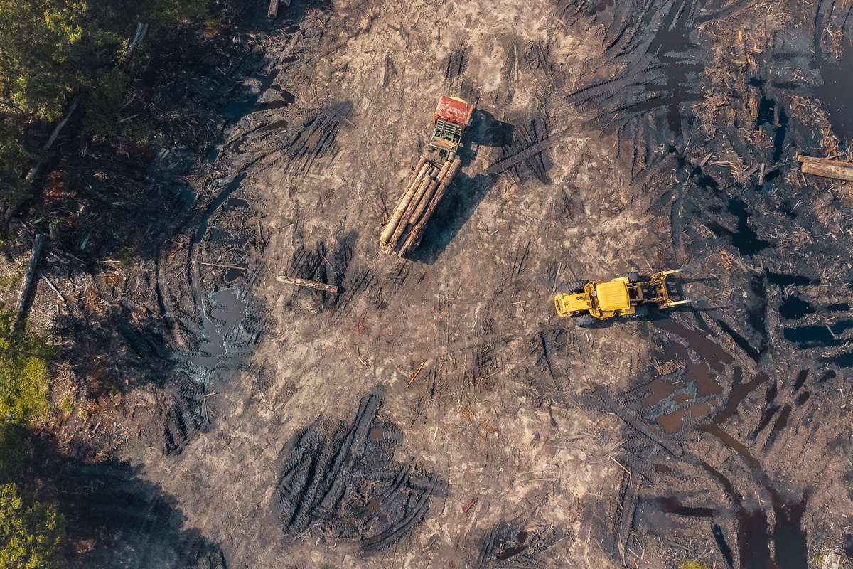

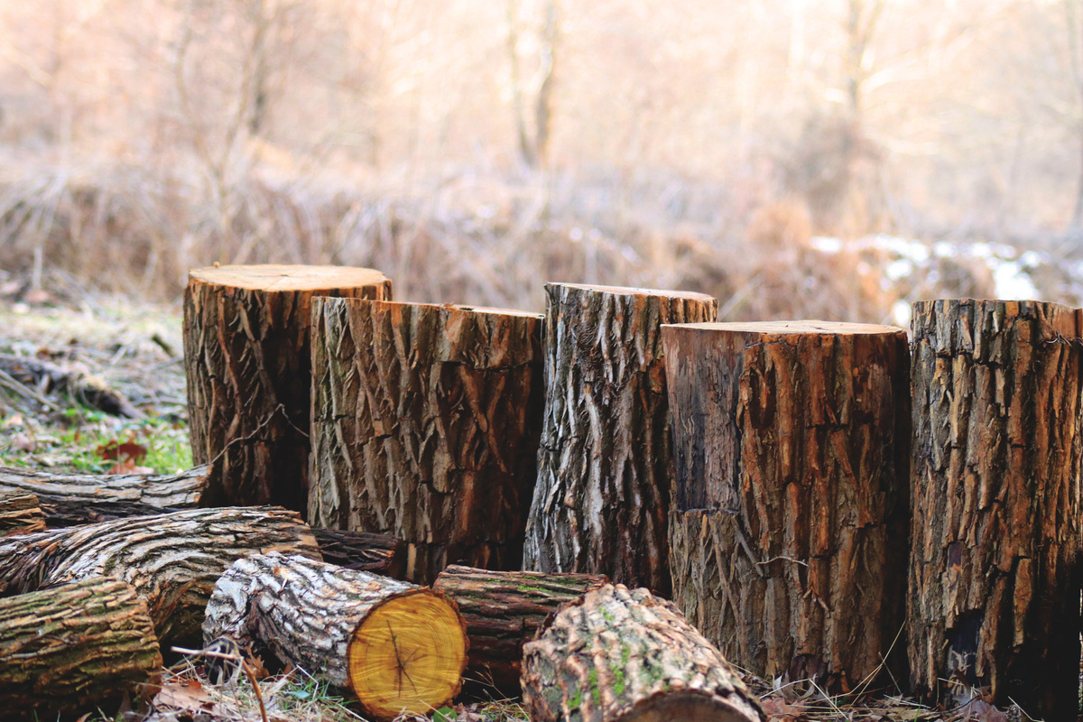

Methodology
Deforestation damages ecosystems, reduces biodiversity, and disrupts the water cycle. Forest loss increases the risk of erosion, flooding, and reduces the availability of fresh water, as well as worsening global climate change.
There are many factors that cause forest destruction, including:
1
2
3
Deforestation for agriculture, plantations and development.
Forest fires.
Illegal logging and the timber industry.

Slide 6


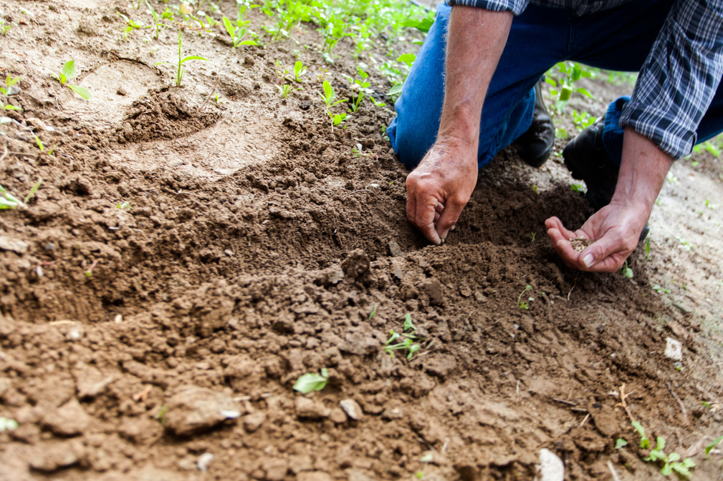
Proposed Solutions
There are various reforestation techniques that can be used depending on land conditions, climate, and the tree species to be planted:
Direct planting
Natural greening
Seed distribution
Explain more about effective reforestation techniques here.
Explain more about effective reforestation techniques here.
Explain more about effective reforestation techniques here.

Slide 7

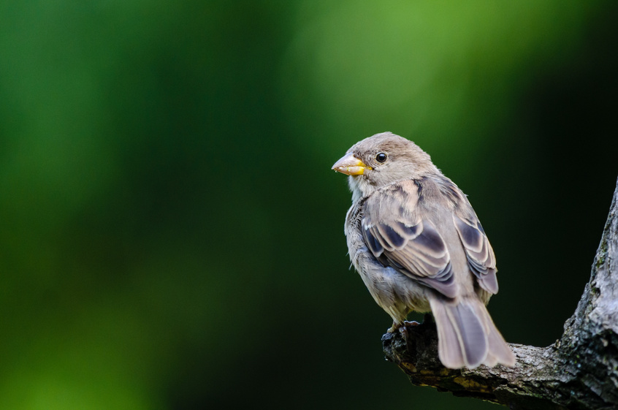
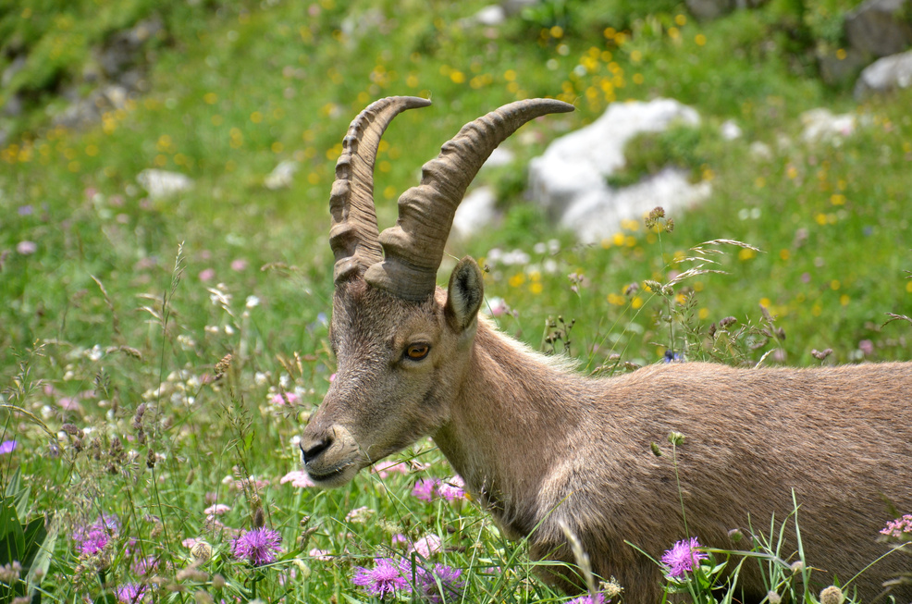
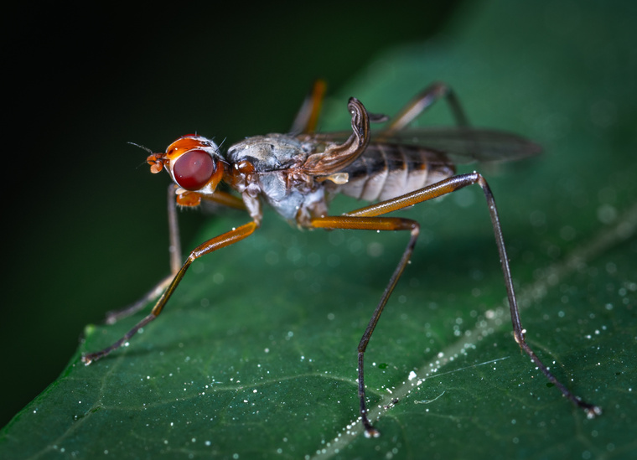
Result and Discussion
Reforestation helps restore habitat for many species that are threatened with extinction due to deforestation. By restoring forests, biodiversity can be protected and endemic species can thrive again.
Examples of species that benefit from reforestation efforts:
Birds
Mammals
Insects

Slide 8

Future Works
One of the best ways to combat climate change is through reforestation. Trees absorb carbon dioxide, the main gas causing global warming. Reforestation helps balance carbon emissions and slows the rise in global temperatures.

Slide 9
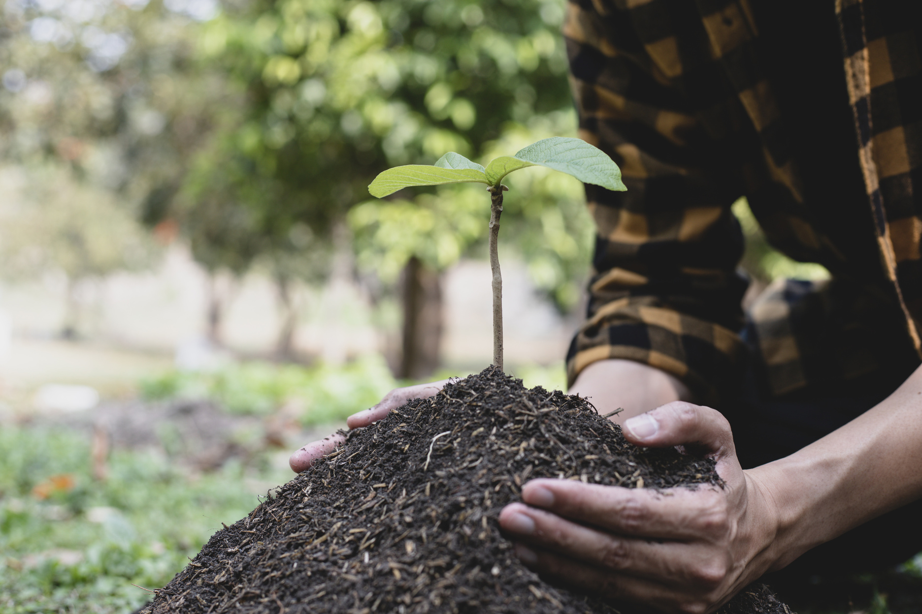

Conclusion
Reforestation is an important step in restoring the environment and maintaining the balance of nature. By raising awareness and participation in reforestation programs, we can help preserve forests and combat climate change. Let's contribute to a greener future by supporting reforestation initiatives.

Slide 10






INTERNATIONAL CONFERENCE
THANK YOU!
ON
BORNEO SUSTAINABILITY 2025
“Empowering Borneo, Inspiring the World”
Presenter Name
Email address
Contact Number
Website

